Slide 1
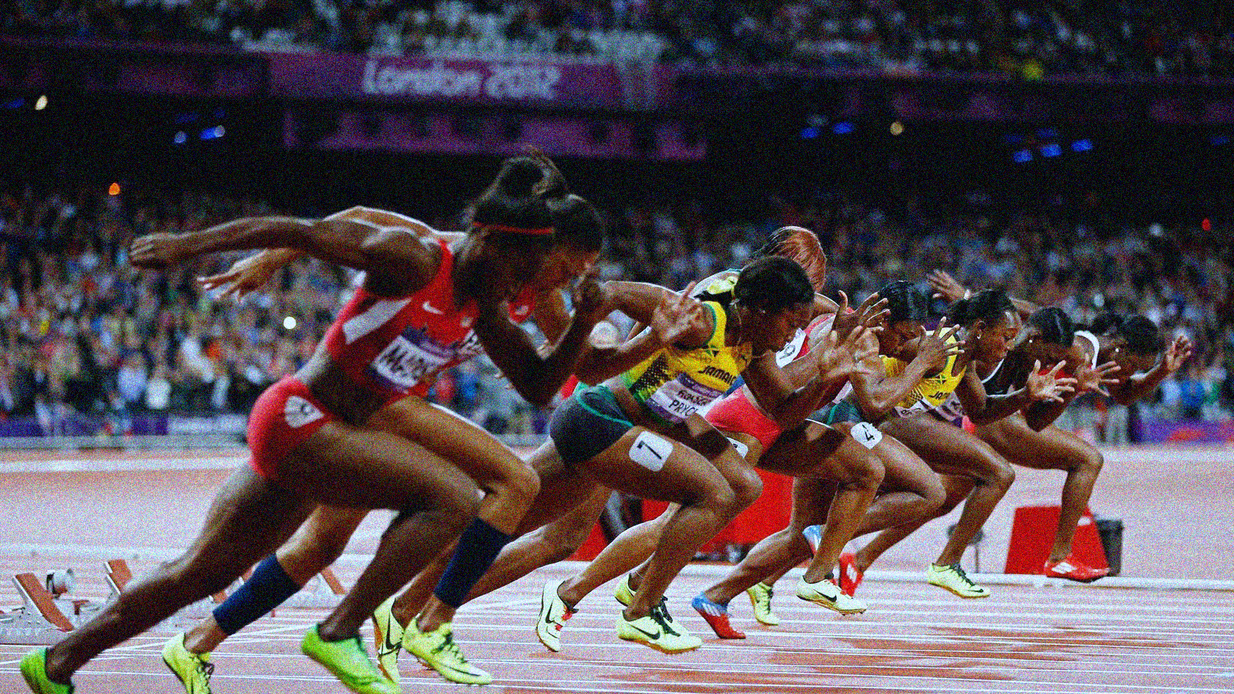
Slide 1
DSAI MINI PROJECT
Callista Chang | U1821324G
Ooi Yuxuan | U1822211J
Wu Sibing | U1822553G

Slide 2

Can we create a model to predict future medal tallies?
Dataset used: 120 Years of the Olympic Games

Slide 3

Data Cleaning
How we created our 2 root datasets (Summer Olympics and Winter Olympics datasets)

Slide 4
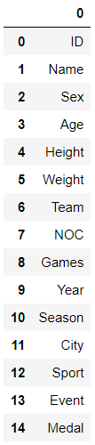
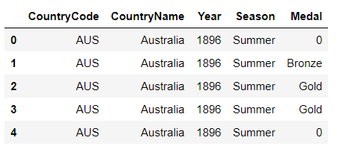
athelete_events.csv
columns
main_dataset
ibiblio.org HTML table + faulty_codes_dict
noc_regions.csv
“noc_regions.csv”
Country Code → Country Name
ibiblio.org HTML table
ISO 3-Alpha Country Code → IOC Olympic Country Code
faulty_codes_dict
Manually change some rows of inconsistent country codes

Slide 5
Factors we have identified through research
GDP Per Capita
Host Country (Yes/No)
Medals earned in the Summer/Winter Olympics of the same season
Population Size
Medals earned in the previous season

Slide 6
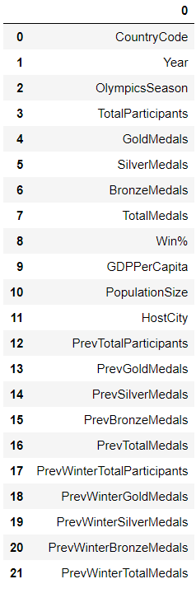
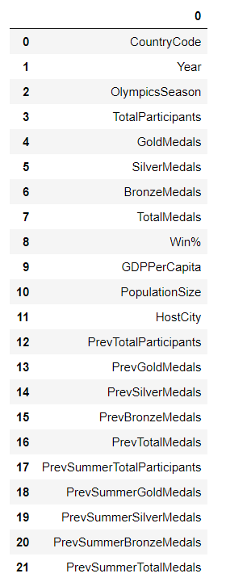
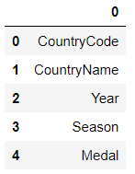
summer_dataset columns
winter_dataset columns
2812 rows
1236 rows
main_dataset
columns
Prev Summer
Olympics
Cleaned data for external .csv files:
World GDP Per Capita (1960-2016)
World Population Size (1960-2016)
Olympics Host Countries
Prev Winter
Olympics

Slide 7

Data Visualisation
Medal Tally Visualisation (Over the Years & By Country)
Medal Tally vs. Predictors Visualisation (Correlation Matrix)

Slide 8
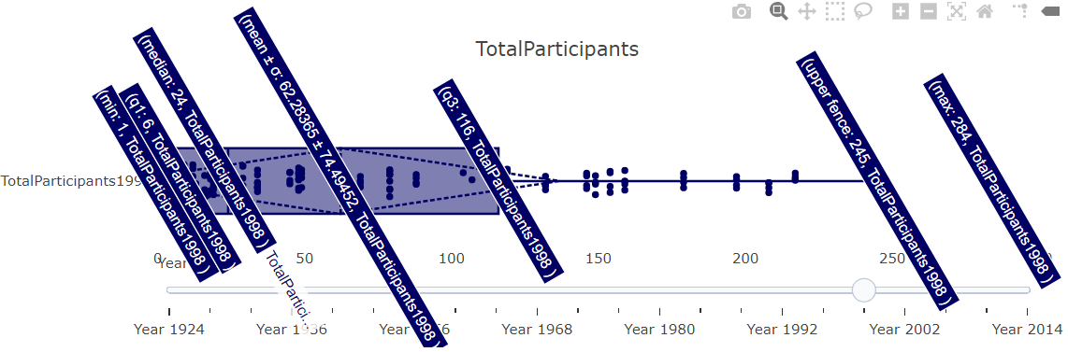
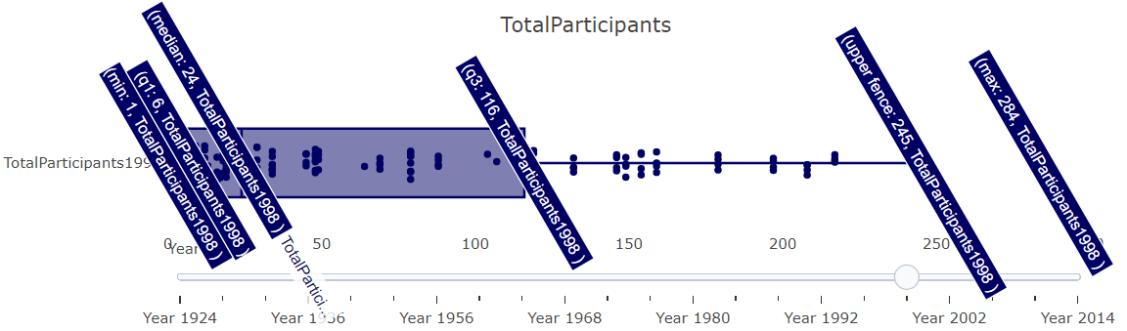
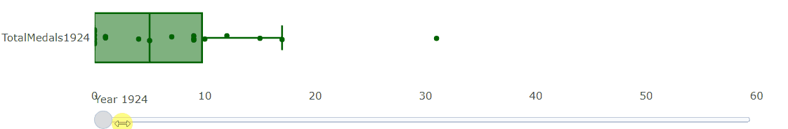
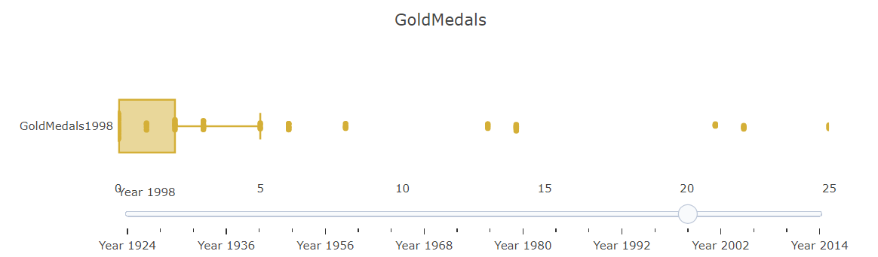
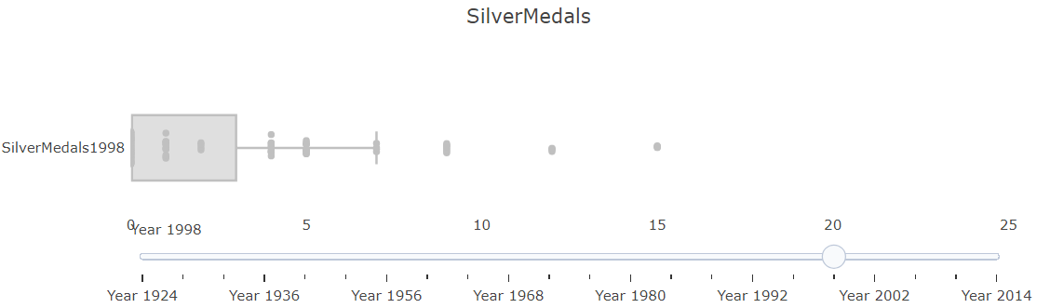
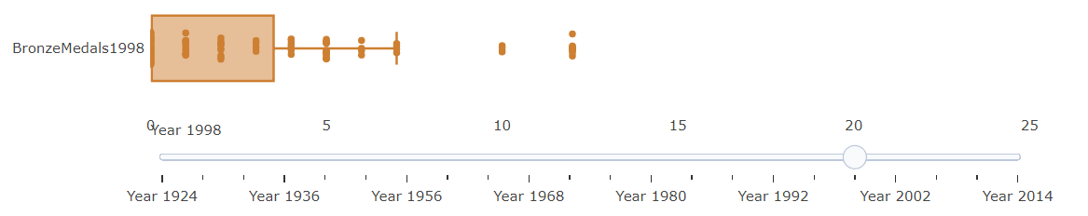
Medal Tally & Total Participants Visualisation
Total Participants 1998 Winter
Total Winter Olympics Medals Over the Years
Gold, Silver & Bronze Medals 1998 Winter
Median, IQRs, mean, standard deviation for each year’s medal tallies easily observable
Slider to go through the years
Compare gold, silver and bronze medal tallies side by side
Plotly Boxplots

Slide 9
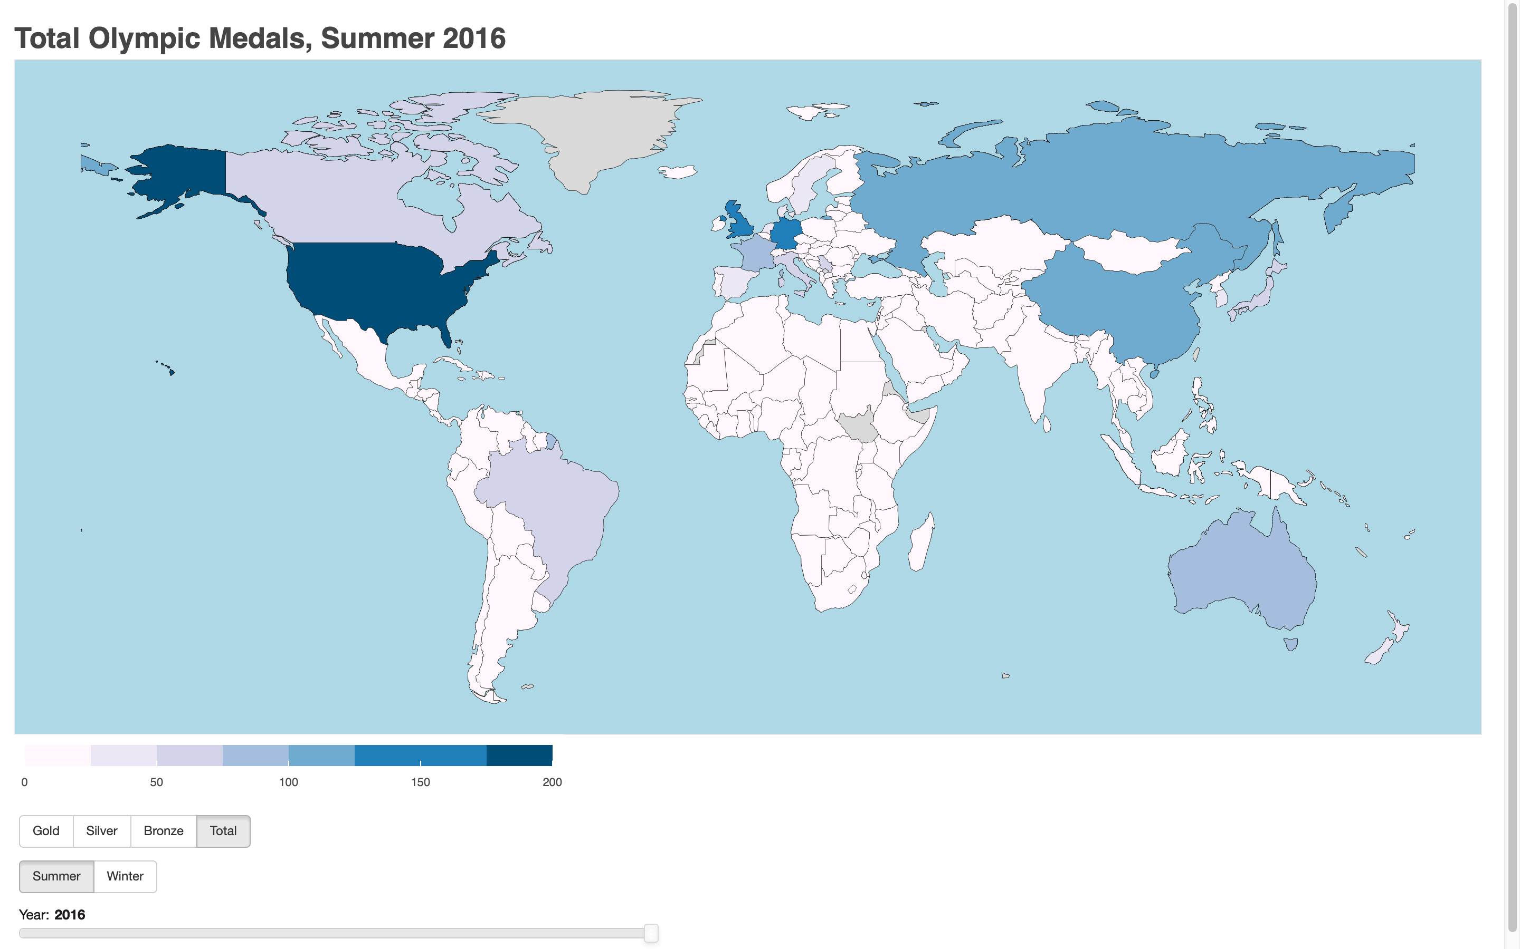
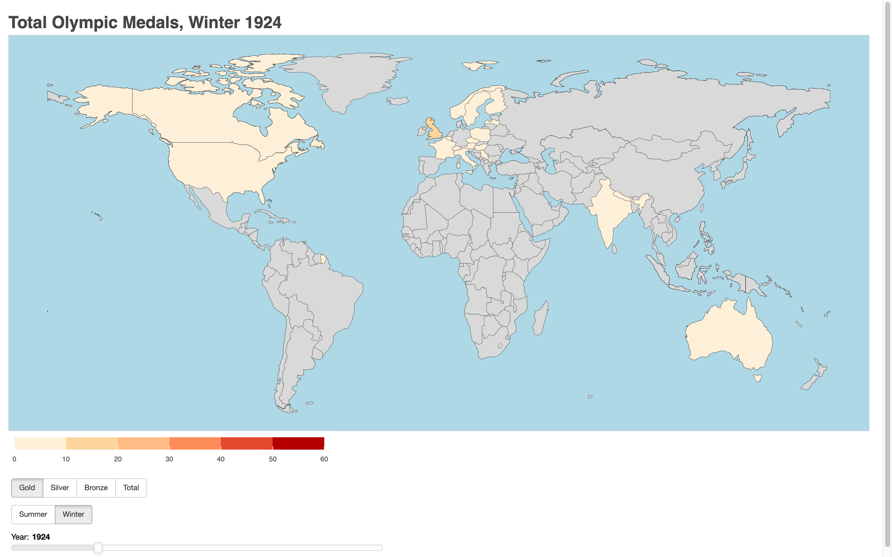
Medal Tally Choropleth Visualisation
`
Bokeh Choropleth Map
Filter by Medal Type and Type of Olympics
(Button Interactivity)
Bokeh Choropleth Map
Timeline from the 1st Olympics
(Slider Interactivity)

Slide 10
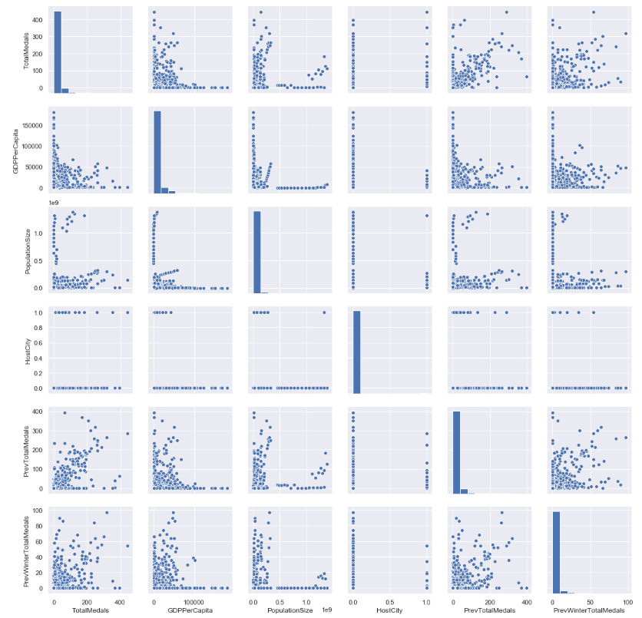
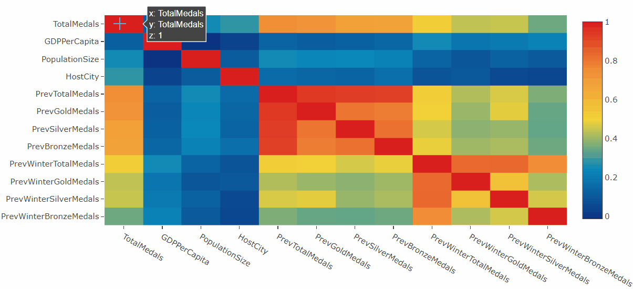
Total Medals vs. Predictors Visualisation
Seaborn Pairplot
Create a correlation matrix between Total Medals and major predictors for the Summer Olympics dataset
Plotly Heatmap

Slide 11
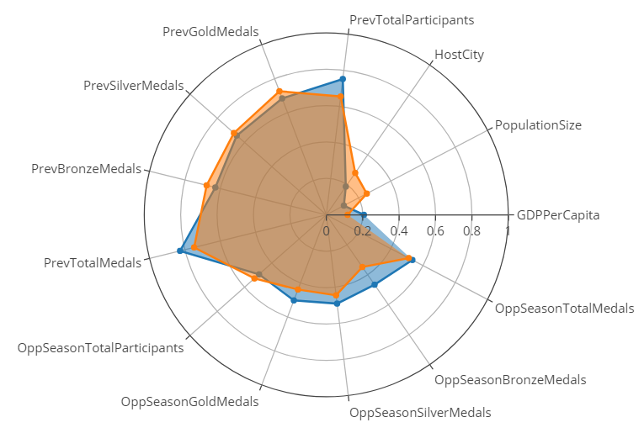

Total Medals vs. Predictors Visualisation
Plotly Radar Chart
We found that the factors with highest correlation to Total Medals are…
Medals earned in the previous season
Medals earned in the Summer/Winter Olympics of the same season

Slide 12

Machine Learning Models
Regression – Multivariate Linear Regression & Convolutional Neural Network (Keras)
Classification – Random Forest
Ensemble Learning

Slide 13
Pipeline for Models
Dataset Split
Prediction
Prediction
Random Forest
Random Forest
CNN
Linear Regression
CNN
Linear Regression
Ensemble Learning
Ensemble Learning

Slide 14
Dataset Split
Olympic Dataset
Summer Dataset
Winter Dataset
Test
Test
Train
Train
Perform logarithm to “Population” and “GDP”
To reduce weightage
Insufficient data for validation set
Use data from latest year to test the goodness of the model

Slide 15
Pipeline for Models
Dataset Split
Prediction
Prediction
Linear Regression
Random Forest
CNN
Linear Regression
Random Forest
CNN
Ensemble Learning

Slide 16
Prediction Models
Multivariate Linear Regression
Apply linear regression to every country
Combine all the results together
Random Decision Forest
Apply random forest model to every country
Combine all the results together
Convolutional Neural Network (CNN)
Fully-connected layers + dropout
Adjust the hyperparameter
Apply the model to the whole dataset

Slide 17

Outcome
High Explained Variance &
Low Mean Squared Error
→ Good Model
Prediction Models | Season | R² | MSE
Linear Regression | Summer | 0.97668208 | 20.57142857
 | Winter | 0.98596928 | 03.93589743
Random Forest | Summer | 0.98382429 | 14.50510204
 | Winter | 0.98094705 | 05.69230769
CNN | Summer | 0.82793978 | 151.80612244
 | Winter | 0.66291537 | 96.96153846
$$√$$
$$√$$

Slide 18
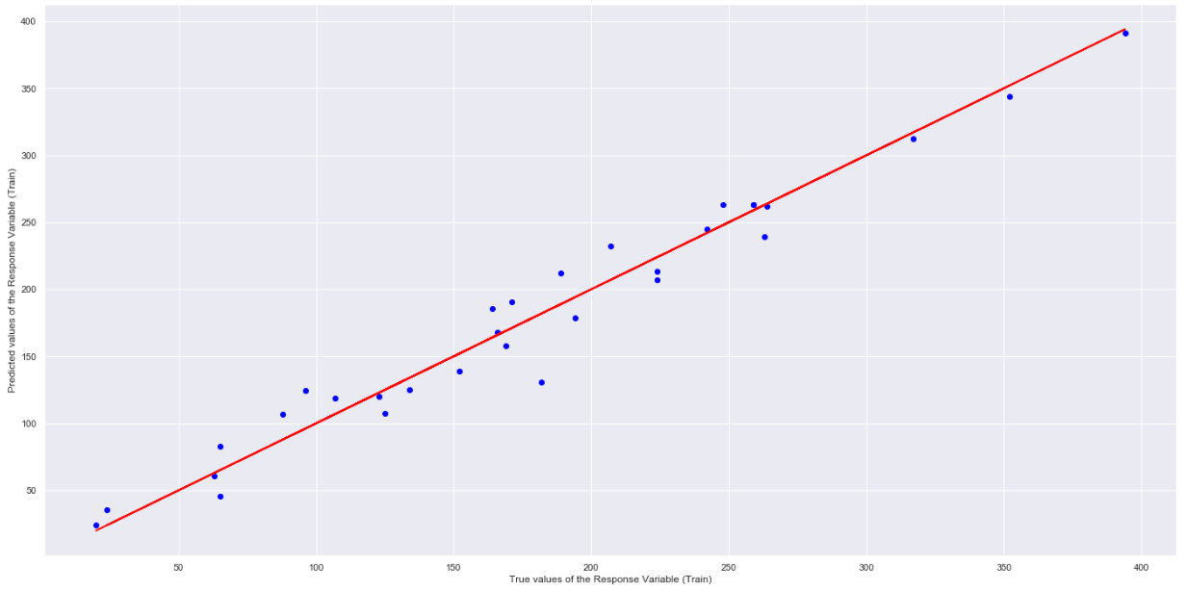
Multivariate Linear Regression
Plotted predicted values of train dataset versus true values of train dataset for USA’s performance in the Summer Olympics
Matplotlib Linear Regression Plot

Slide 19
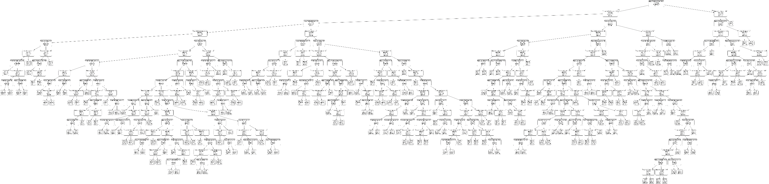
Random Decision Forest
Imported sklearn.ensemble.RandomForestRegressor
Supervised learning algorithm
Builds multiple decision trees to get a more accurate and stable prediction

Slide 20
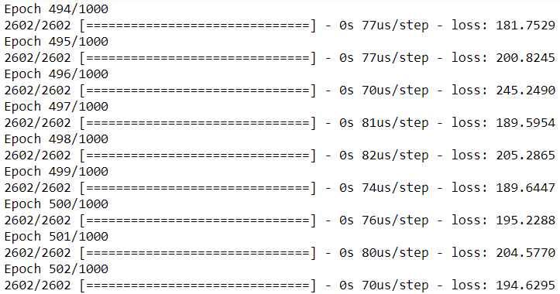
CNN
Imported tensorflow.keras
Deep learning algorithm, model training

Slide 21
Pipeline for Models
Dataset Split
Prediction
Linear Regression
Random Forest
CNN
Ensemble Learning
Ensemble Learning

Slide 22
Ensemble Learning
Weighted average
Weightage decided via Mean Squared Error (MSE)
Combination with the lowest MSE
Final Prediction Model =
LinearRegressionWeightage * linear_model +
RandomForestWeightage * random_forest_model +
CNNWeightage * cnn_model

Slide 23
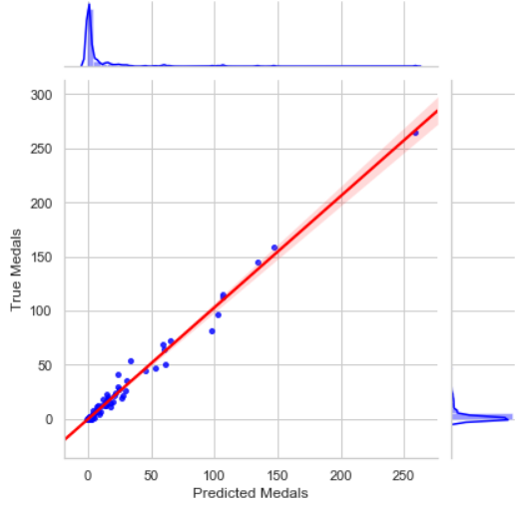
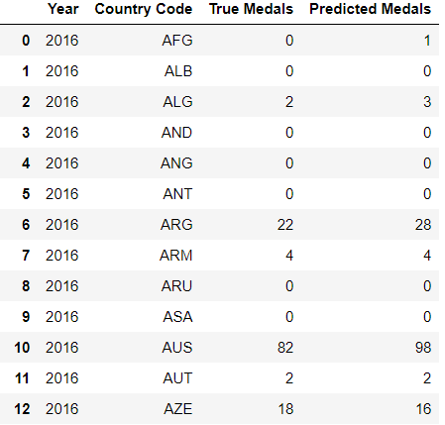
Effectiveness of Ensemble Learning Model (Test on 2016 Olympics)
We predicted for the 2016 Summer Olympics using 1960-2012 train data
Rather accurate from observation
Seaborn Jointplot

Slide 24

Conclusion
Predicting the Medal Tally for the upcoming 2020 Summer Olympics

Slide 25
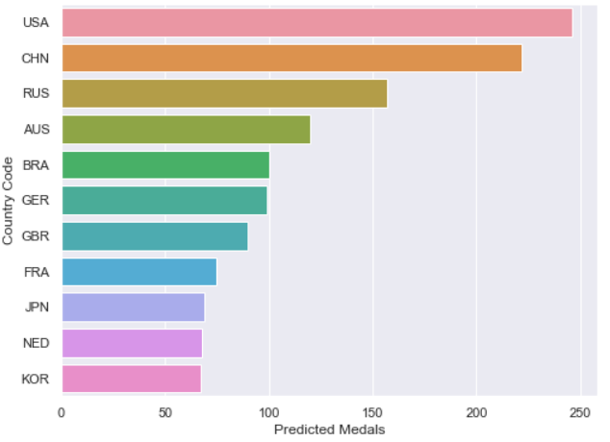
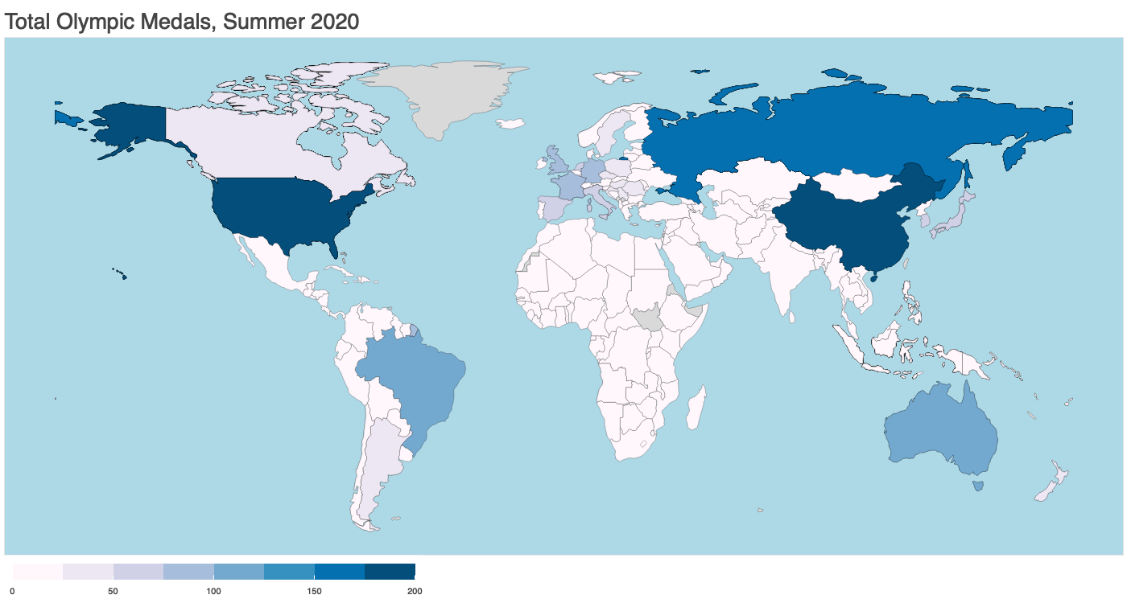
Prediction of 2020 Summer Olympics – Top 10
Rank | Country | Predicted Medals
1 | USA | 246
2 | China | 222
3 | Russia | 157
4 | Australia | 120
5 | Brazil | 100
6 | Germany | 99
7 | Great Britain | 90
8 | France | 75
9 | Japan | 69
10 | Netherlands | 68

Slide 26
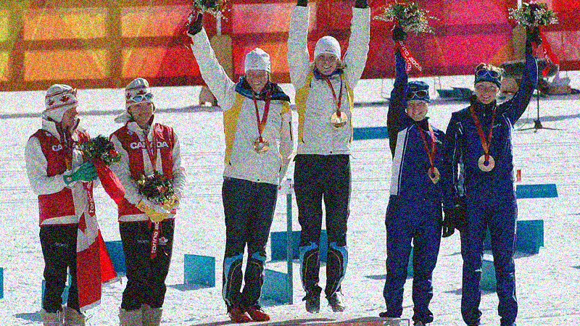
Slide 11
Contributions:
Callista
Data Cleaning
Data Visualisation (Plotly & Seaborn)
Slides
Yuxuan
Data Visualisation (Bokeh)
Slides
Sibing
Machine Learning Models
2020 Medal Tally Prediction
THANK YOU!

